Slide 1
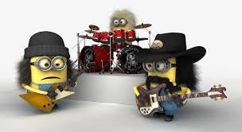
Monophonic vs Polyphony
Timbre in music????
Why do we like
what we like
An Interdisciplinary Approach

Slide 2


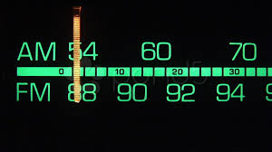
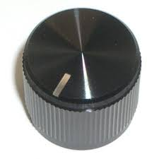
Polyphonic Timbre
Global sound
Why do we like
what we like
An Interdisciplinary Approach

Slide 3
Polyphonic Timbre
Global sound
Why do we like
what we like
An Interdisciplinary Approach
musical genres typically contain prototypical sound mixtures which then describes the global sound
composers also tend to have their own “sound” because of their choice of instruments

Slide 4
Global Sound/Polyphonic Timbre Significance
Perceptual
genre identification and categorization (250ms-3s)(Gjerdingen & Perrott in 1999)
affect identification (500 ms) (Peretz et al. 1998)
agree on basic emotions(1-2sec)(Bigand et al. 2005, Watt & Ash, 1998)
Computational (MFCC)
genre(Tzanetakis et al.,2001, Aucouturier, 2006) ,
mood, emotion (Liu et al., Yang & Lee, Leman et al.)
semantics (Turnbull et al,2008, Slaney, 2002)
Why do we like
what we like
An Interdisciplinary Approach

Slide 5
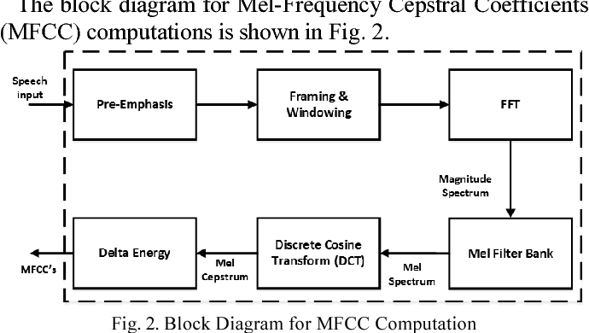
Global Sound/Polyhpnic Timbre Significance
“spectrum-of-a-spectrum"
Computational (MFCC)
genre(Tzanetakis et al.,2001, Aucouturier, 2006) ,
mood, emotion (Liu et al., Yang & Lee, Leman et al.)
semantics (Turnbull et al,2008, Slaney, 2002)
Why do we like
what we like
descriptor of spectral shape based on perception
widely used in speech research (e.g. speech recognition)
perceptual correlates unclear

Slide 6
Perceptual dimensions
What do we perceive/hear when we listen to short bursts of music
An Interdisciplinary Approach
What are the latent dimensions
Alluri, V. and Toiviainen, P. (2010). Exploring perceptual and acoustic
correlates of polyphonic timbre. Music Perception, 27(3):223–241

Slide 7
Research Questions
Which terms are used to describe polyphonic timbre?
Are these terms used consistently?
Can they be predicted from acoustical features?
Alluri, V. and Toiviainen, P. (2010). Exploring perceptual and acoustic
correlates of polyphonic timbre. Music Perception, 27(3):223–241
Notes:
so how can we describe the perceptual qualities that the features represent?
how do we describe what we hear when we listen to music?
How is the mental represenation like when we listen to music?

Slide 8


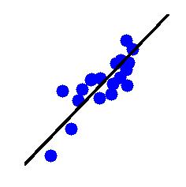
Perceptual and Acoustic Correlates of Polyphonic Timbre
Experiment 1
Devise framework for quantitative assessments
Experiment 2
Evaluate excerpts and uncover underlying perceptual dimensions
Acoustic correlates
Notes:
The goal of Experiment 1 was to devise a framework for acquiring quantitative assessments of polyphonic timbre. This was achieved by means of a survey, which helped in collecting perceptual scales that could be used to describe polyphonic timbre. The participants comprised students or staff members at the Department of Music. Subsequently, in order to reduce the number of perceptual scales, a preliminary listening test was conducted.
Experiment 2 comprised a listening test using the perceptual scales obtained from Experiment 1.
Sound examples
The participants comprised majorly musicians. The behavioural data was subjected to factor analysis to determine the main perceptual dimensions. Following this, computational extraction of acoustic features and correlation analysis helped determine the salient acoustic correlates of the obtained perceptual dimensions.

Slide 9
Perceptual and Acoustic Correlates of Polyphonic Timbre
semantic associations comparable to those of monophonic timbre
Colorful-Colorless
Warm-Cold
Dark-Bright
Acoustic-Synthetic
Soft-Hard
Strong-Weak
Empty-Full
High Energy-Low Energy

Slide 10
Examples
Perceptual dimensions
Activity
Low Activity
High Activity
Brightness
Low Brightness
High Brightness
Fullness
Low Fullness
High Fullness

Slide 11
Acoustic features
Temporal
zero-crossing rate
Spectral
centroid
high energy-low energy ratio
entropy
roll-off 85
MFCC
Spectrotemporal
roughness
sub-band flux
(features extracted using MIRToolbox (Lartillot & Toiviainen)
Notes:
29 features

Slide 12
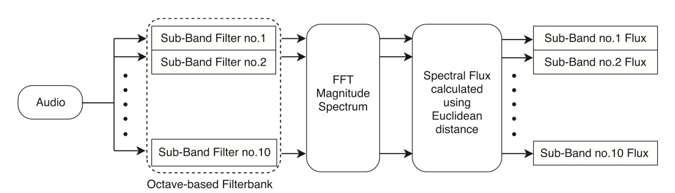
Sub-band Flux

Slide 13

temporal span: static
Acoustic Correlates
acoustic correlates : subband fluxes (spectrotemporal modulations) are best predictors
Activity dimension can be predicted most accurately with acoustical features
MFCCs fail to predict
Fullness
Activity
Brightness
low
mid
high
Notes:
as Fullness (spectral flux of the lower end of the spectrum) and Activity (spectral flux of the mid to high end of the spectrum and Brightness (related to high end activity)

Slide 14
temporal span: static
so the Finns rated a bunch of Indian audio samples
does that mean that our perception of global sound is the same?
Notes:
as Fullness (spectral flux of the lower end of the spectrum) and Activity (spectral flux of the mid to high end of the spectrum and Brightness (related to high end activity)

Slide 15

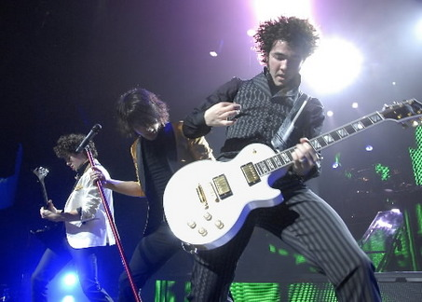
Study 2 : Effect of enculturation on semantic and acoustic correlates of polyphonic timbre
IW
WI
non-musicians
W W
I I
Notes:
II,WI was done in India with all of Indian origin,participant background
t-tests revealed no significant differences for age and number of listening hours per week between the groups
participant origins

Slide 16
Correlation Between Listener Groups
Indian Stimuli
Western Stimuli
all p<.001
Correlation between listener groups
Notes:
Blue indicates the correlations between listener groups for the the respective rating scale for Indian stimuli. And red - Western stimuli.
As can be seen, overall correlations are higher for Western stimuli:
asymmetry of musical familiarity,
High Cronbach alphas hence for each group we tool the mean ratings for all scales for each participants group

Slide 17
Intrinsic Dimensionality
Factor Analysis (Kaiser criterion)
 | II | IW | WI | WW
No. of factors | 3 | 2 | 2 | 3
familiarity
- increases dimensionality of perceptual timbre space
- enhances perceptual acuity
Notes:
Next to investigate the intrinsic dimensionality of the polyphonic timbre space, we performed factor analysis
for comparison we used 2 factor solutions
kaiser criterion retains those factors that explain more variance than any individual variable (on the average, I think)

Slide 18

Perceptual Dimensions
Loadings for Factor 1
Brightness
High Brightness Scores
I I
IW
WI
WW
Low Brightness Scores
soft-hard
empty-full
h.energy-
l.energy
warm-cold
bright-dark
strong-weak
colorful-colorless
acoustic-synthetic
Notes:
high loadings from the scales colorful-colorless, dark-bright, wrm-cold

Slide 19
Perceptual Dimensions
Loadings for Factor 2
High Activity
Scores
Activity
I I
IW
WI
WW
Low Activity
Scores
warm-cold
soft-hard
empty-full
bright-dark
h.energy-
l.energy
strong-weak
colorful-colorless
acoustic-synthetic
Notes:
high loadings from the sacles soft-hard,h.energy l.energy, strong-weak

Slide 20
Acoustic Feature Correlation
Brightness
0.8
I I
I W
W I
W W
0.4
0
-0.4
-0.8
H.energy-
L.energy ratio
ZCR
Correlation Value
Centroid
Entropy
Rolloff85
Roughness
Sub-Band No.1 flux
Sub-Band No.2 flux
Sub-Band No.3 flux
Sub-Band No.4 flux
Sub-Band No.5 flux
Sub-Band No.6 flux
Sub-Band No.7 flux
Sub-Band No.8 flux
Sub-Band No.9 flux
Sub-Band No.10 flux
Notes:
Similar correlation patterns across stimulus sets, it is noteworthy that for both perceptual dimensions the acoustic profiles are similar across the groups.
The correlation pattern for each group and for each perceptual dimension will subsequently be referred to as the acoustic profiles. The correlations suggest that perceptually bright stimuli possess relatively more high frequency energy (zero-crossing rate, spectral centroid) than less bright stimuli. In addition, Bright stimuli tended to have more fluctuation in the higher frequency regions (Sub-Bands no. 7-10) and less fluctuation in the lower frequency regions (Sub-Bands No. 1-2).

Slide 21
Acoustic Feature Correlation
Activity
Activity
0.8
0.4
0
-0.4
I I
I W
W I
W W
-0.8
H.energy-
L.energy ratio
ZCR
Correlation Value
Centroid
Entropy
Rolloff85
Roughness
Sub-Band No.1 flux
Sub-Band No.2 flux
Sub-Band No.3 flux
Sub-Band No.4 flux
Sub-Band No.5 flux
Sub-Band No.6 flux
Sub-Band No.7 flux
Sub-Band No.8 flux
Sub-Band No.9 flux
Sub-Band No.10 flux
Notes:
point out correlations are high - around .75
the stimuli with higher Activity scores tend to be associated with higher flux in the high end of the spectrum, in particular at frequencies around 1600-3200 Hz (Sub-Bands No. 7), more energy in the higher frequency bands when compared to the lower frequency bands (high energy-low energy ratio), and a more even spectral distribution (entropy).
Overall, the acoustic features correlated more highly with Activity than with Brightness. Nevertheless, it is noteworthy that for both perceptual dimensions the acoustic profiles are similar across the groups.

Slide 22
Conclusion
Overall results hint at the existence of universal patterns in polyphonic timbre perception
Activity, Brightness - common perceptual dimensions
increase in intrinsic dimensionality
enculturation
musical expertise
can genre, emotion be identified based on these two dimensions?

Slide 23

What makes a Genre?
What makes a genre?

Slide 24
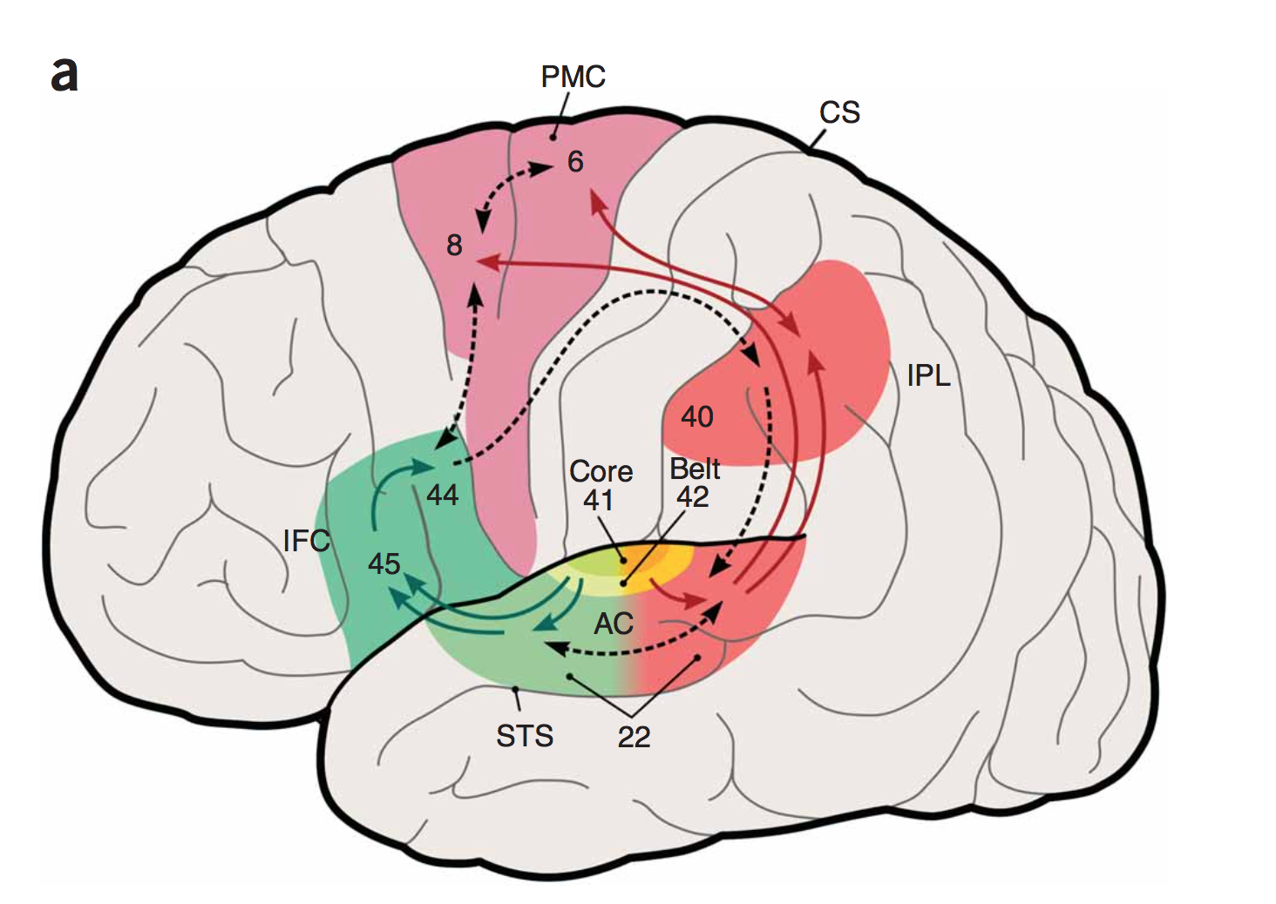
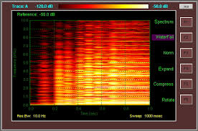
Dual Pathways in the brain
represent the “where” and “what” of the sound
postero-dorsal stream encompasses both spatial and language functions
antero-ventral auditory pathway important in auditory pattern recognition and object identification and is hierarchically organized
where
Rauschecker and Scott, 2009
what

Slide 25
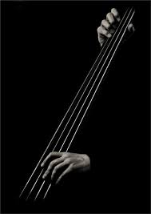
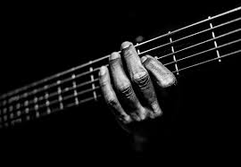
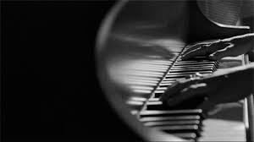
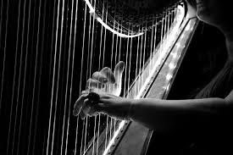

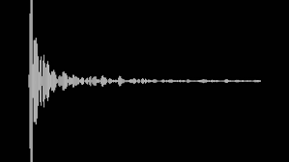
“hierarchical”
levels of abstraction
basis to hypothesise where timbre is encoded in the brain
Notes:
Timbre processing in the brain can be discussed in relation to the levels of abstraction

Slide 26
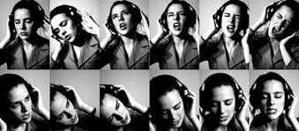

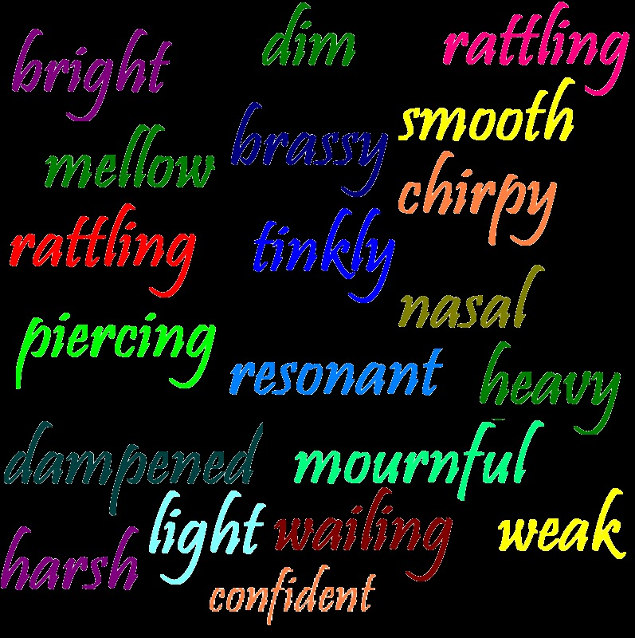
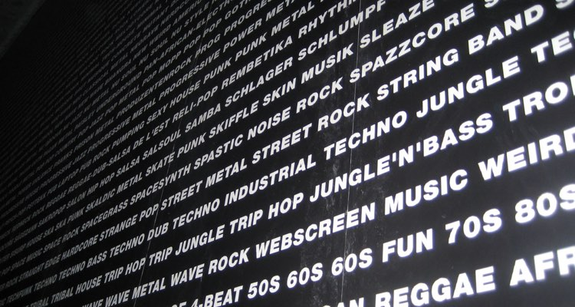
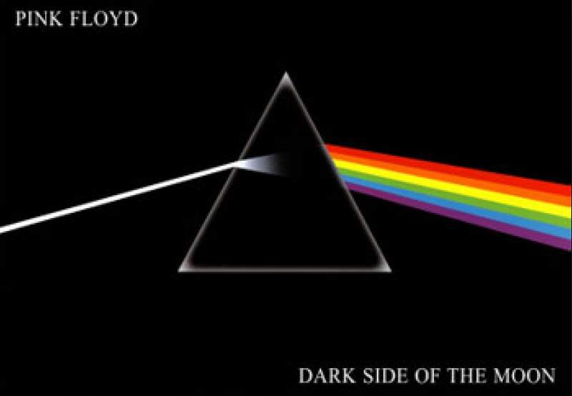
levels of abstraction
low levels associated with representation of acoustic structure
high levels associated with representation of sound source properties
higher levels associated with identification, description, and categorization of prototypical mixtures of sources (polyphonic timbre/global sound)
Aucouturier 2006; Alluri and Toiviainen, 2010; Ferrer 2011
Notes:
until recently neuroscientific studies have typically looked into neural correlate of timbre based on operational or functional definitons of abstraction

Slide 27
“What” Pathway in the brain
stemming from the primary auditory cortex
mid-level representations formed in the secondary areas STS and in anterior portions of the STG
debated that abstraction extends both in anterior and posterior directions starting from A1
right-hemispheric bias.
what
Rauschecker and Scott, 2009
Notes:
Low-level timbre processing begins already in the primary auditory pathway by means of spectral decompositions followed by distributed representation in the auditory cortices. Stemming from the primary auditory cortex, mid-level representations form in the secondary areas such as STS and in anterior portions of the STG with a right-hemispheric bias.

Slide 28







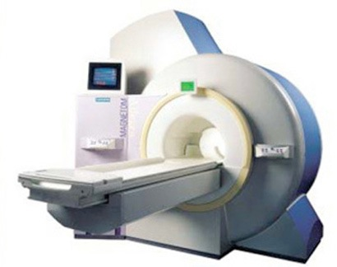

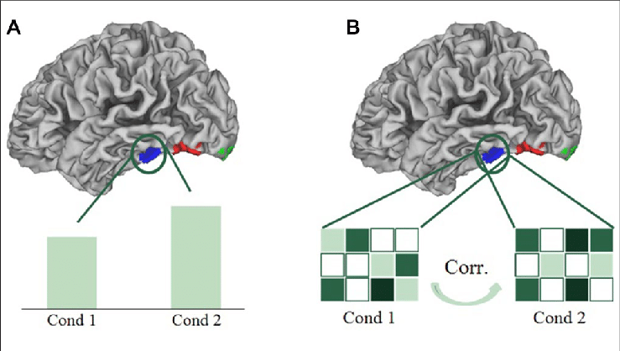
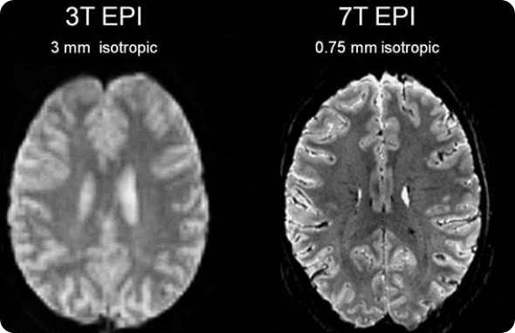
modelling: decoding genre
6 sec long excerpts
fMRI responses
musical genre

Slide 29
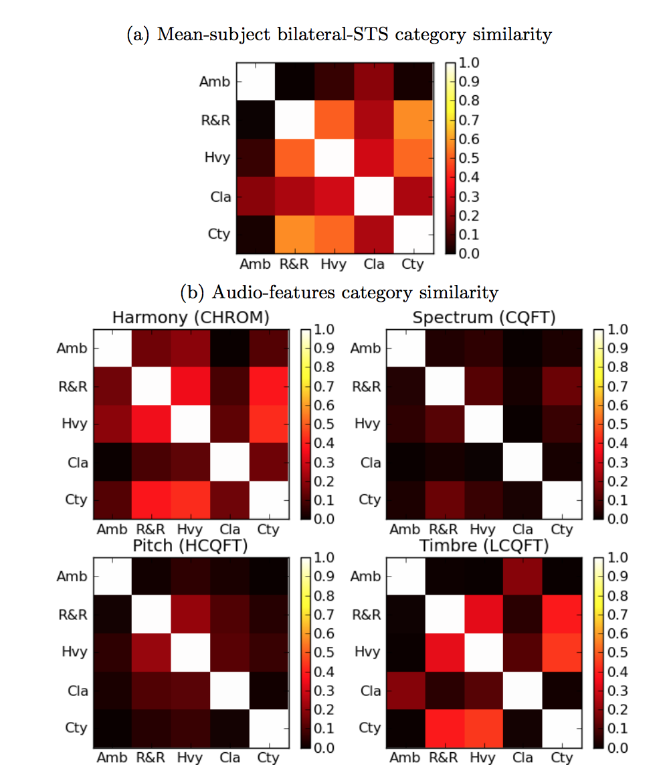

Results
modelling: decoding genre
restricted to bilateral STS
highest correlation between similarity structure of timbral features of the stimuli resembled the similarity structure of the STS than tonality and pitch
timbral features were most accurate in predicting the image response
“distributed population code in bilateral STS responsible for genre discrimintation"
Casey, M., Thompson, J., Kang, O., Raizada, R., and Wheatley, T. (2012). “Population codes representing musical timbre for high-level fmri categorization of music genres,” in Machine Learning and Interpretation in Neuroimaging (Sierra Nevada: Springer), 34–41.

Slide 30

Results
modelling: decoding genre
MVPA restricted to bilateral STS
highest correlation representation similarity analysis (RSA) matrix of timbral features (cepstral features - “the way the stimulus sounds”) with that of STS than tonality and pitch
“distributed population code in bilateral STS responsible for genre discrimintation"
timbral features were most accurate in predicting the image response
Casey, M., Thompson, J., Kang, O., Raizada, R., and Wheatley, T. (2012). “Population codes representing musical timbre for high-level fmri categorization of music genres,” in Machine Learning and Interpretation in Neuroimaging (Sierra Nevada: Springer), 34–41.

Slide 31
song & genre decoding from fMRI
Forrest database
7 tesla scanner
20 participants
25 excerpts (6-sec), 5 genres
ROIs: Heschl’s gyrus, anterior STG, posterior STG
Support Vector Machine classifier

Slide 32
Results
modelling: decoding genre
timbral features best decoded
restricted to bilateral HG and STG
STG predicted better than HG perceptual genre classifications
Primary and Secondary auditory cortex
Casey, M. A. (2017). Music of the 7Ts: Predicting and decoding multivoxel fMRI responses with acoustic, schematic, and categorical music features. Frontiers in Psychology, 8, 1–11. http://doi.org/10.3389/fpsyg.2017.01179

Slide 33
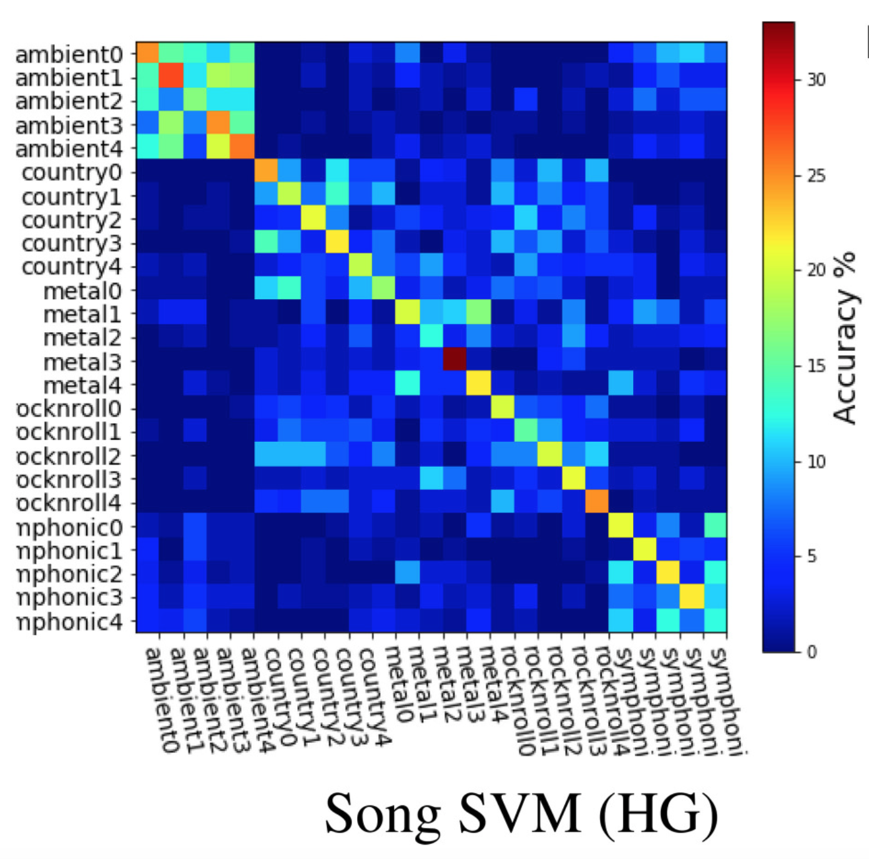
results / song classification

Slide 34
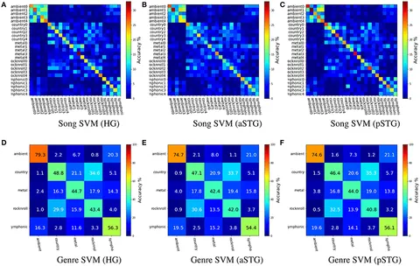
Songs mean classification accuracy = 15.95%
Hypothesis
Genre mean classification accuracy = 60%
Vinoo Alluri
The figures show that distinct anatomical ROIs yield similar relational information about music. The patterns of misclassifications show that when songs are misclassified, they are more likely to be confused with items from the same genre, or a similar sounding genre: e.g., Ambient and Symphonic; and Rock-n-Roll and Country.
Casey, M. A. (2017). Music of the 7Ts: Predicting and decoding multivoxel fMRI responses with acoustic, schematic, and categorical music features. Frontiers in Psychology, 8, 1–11. http://doi.org/10.3389/fpsyg.2017.01179
Notes:
The figures show that distinct anatomical ROIs yield similar relational information about music. The patterns of misclassifications show that when songs are misclassified, they are more likely to be confused with items from the same genre, or a similar sounding genre: e.g., Ambient and Symphonic; and Rock-n-Roll and Country.

Slide 35
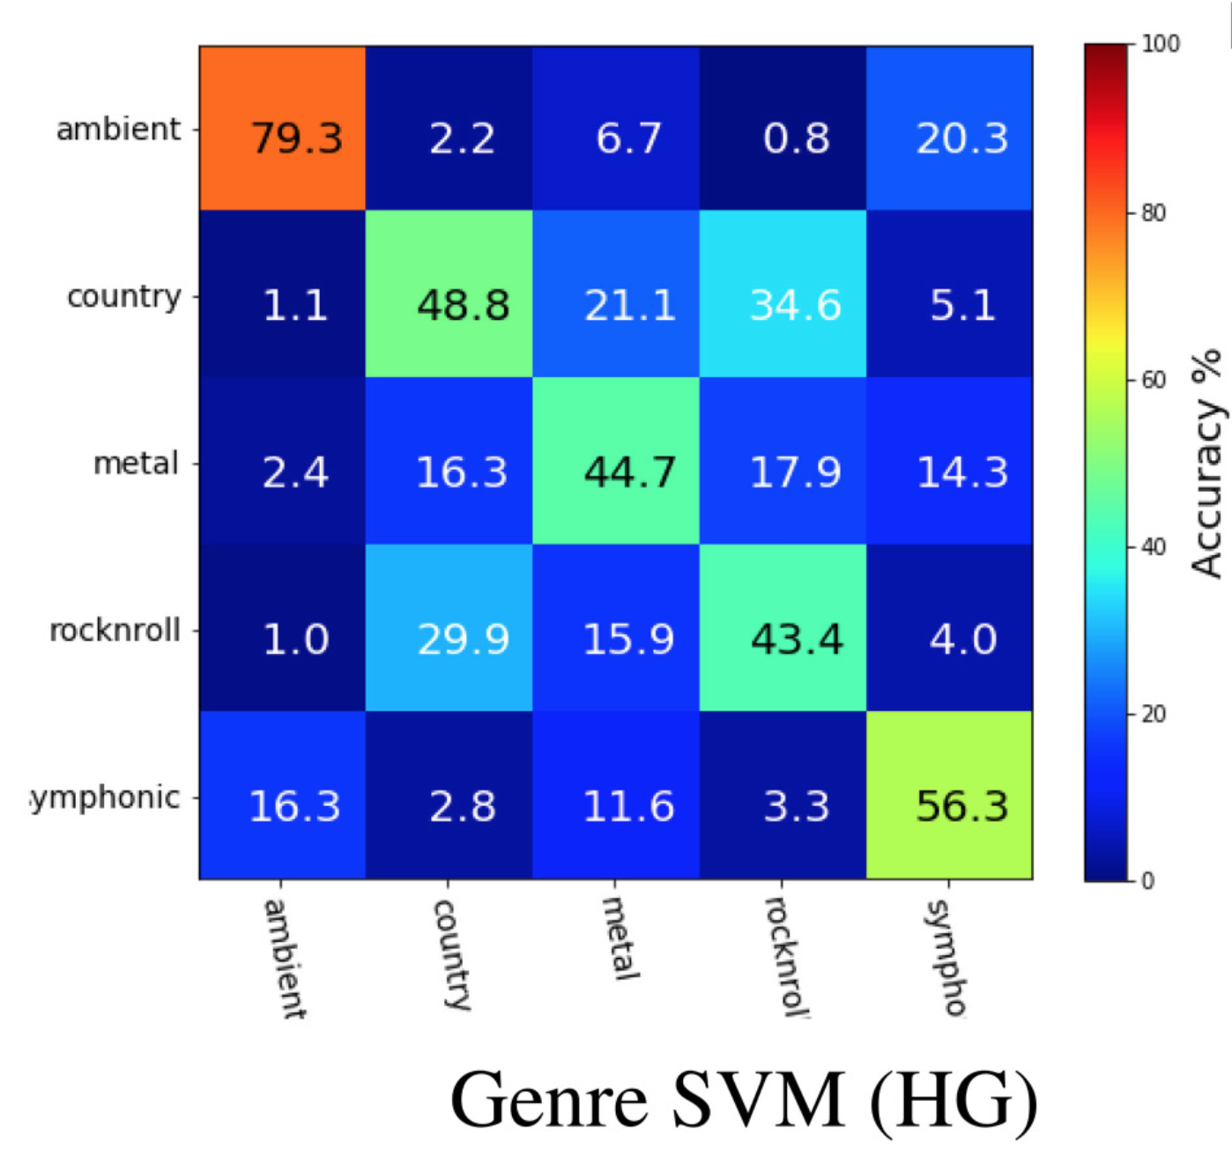
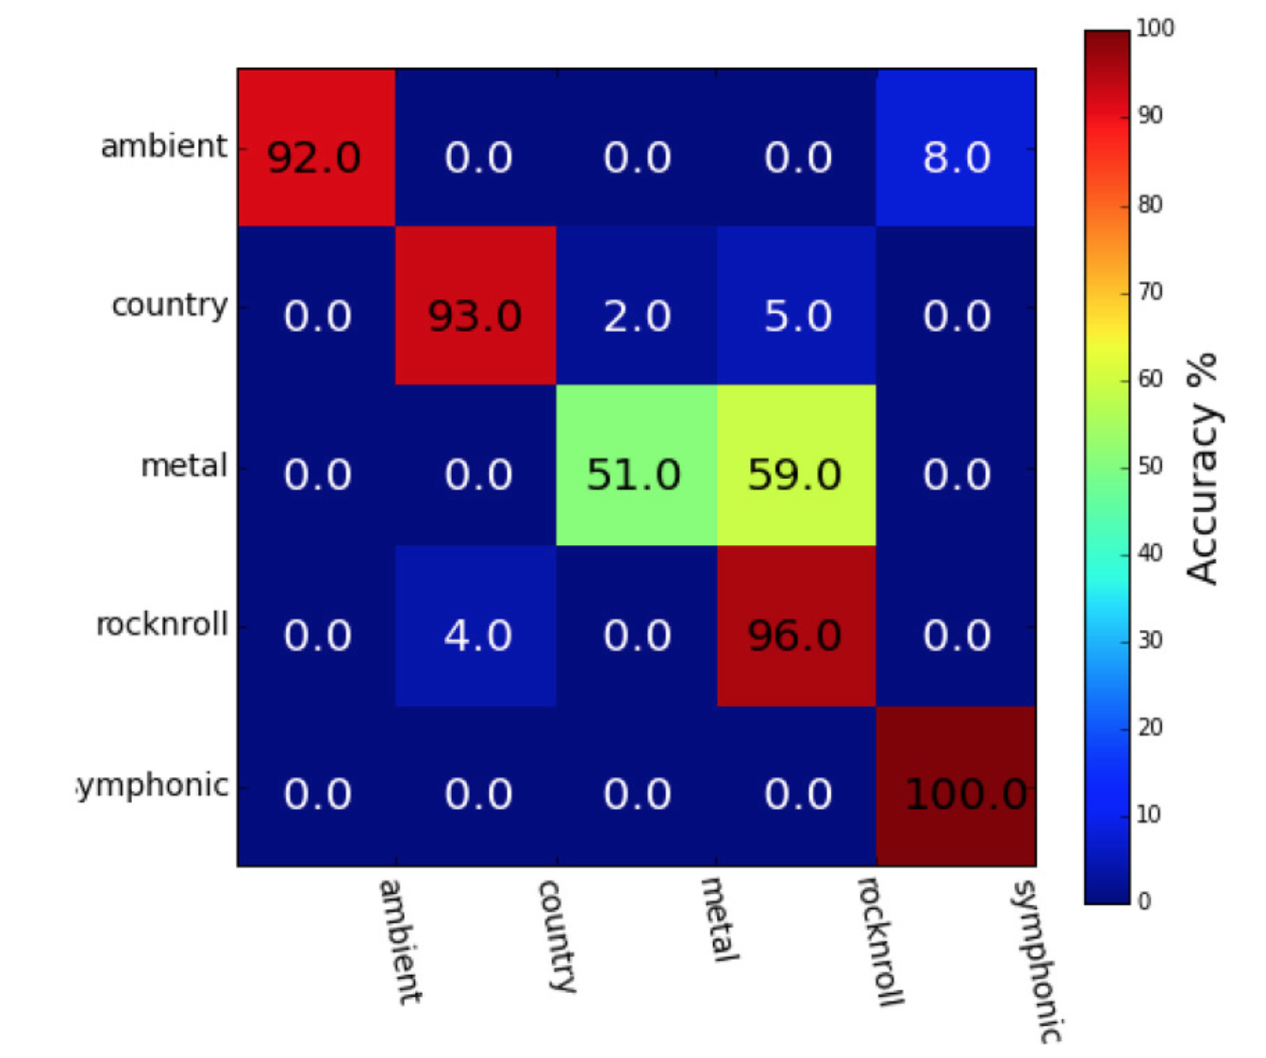

results / genre classification
—> the pattern of confusions exhibited by the classifiers was significantly correlated with confusions in a behavioral categorization task

Slide 36
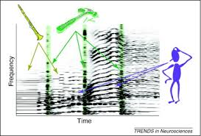
Sensory Perception

Slide 37
How many violins/violinists/streams do you hear?
3:40 4:29 6:56
Sensory Perception

Slide 38
Levels of Music Processing
time scale
mood
100 s
style
emotions
form
tension
similarity
10 s
Concepts
melody
harmony
tonality
scale
meter
1 s
segments
streams
dissonance
chords
dynamics
pulse
Structure
0.1 s
pitch
duration
timbre
loudness
location
Features
audio
Signal
Notes:
level 1: single events
level 2: a few events

Slide 39
Levels of Music Processing
mood
style
emotions
semantic
form
tension
similarity
interpretation
meaning
Concepts
melody
harmony
tonality
scale
meter
segments
streams
dissonance
chords
dynamics
pulse
structure
syntactic
pitch
duration
timbre
loudness
location
audio
Signal
Notes:
context meaning: musical context or extra-musical context

Slide 40
Levels of Music Processing
time scale
mood
100 s
style
emotions
form
tension
similarity
10 s
Concepts
melody
harmony
tonality
meter
1 s
segments
streams
dissonance
chords
dynamics
pulse
Structure
0.1 s
pitch
duration
timbre
loudness
location
Features
audio
Signal
Notes:
level 1: single events
level 2: a few events

Slide 41
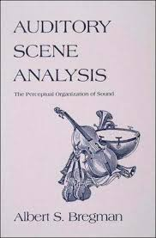
Sensory Perception
Perception and Perceptual Organisation

Slide 42
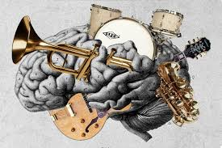
Sensory Perception
Perception and Perceptual Organisation
“Music is in the ear of the beholder”

Slide 43
Auditory scene analysis
tonotopic organization (Ress & Chandrasekaran, 2013)
coined by Albert Bregman
proposed model for the basis of auditory perception - the auditory system needs to make sense of the superposition of component sounds (the auditory scene).
human auditory system segregates and organizes sound into perceptually meaningful elements or auditory streams from an incoming mixed stream
it needs to group the components of the sound that come from the same sound source
ability to determine location and distance of sound
many of these can be explained by auditory analogues of the Gestalt principles

Slide 44
Gestalt Theory
Gestalt: shape or form
started in 1890s
Kurt Koffka, Max Wertheimer, Wolfgang Köhler
reaction to atomism (nature of things is absolute and not dependent on context)
holistic/gestalt: the whole is something else than the sum of its parts

Slide 45
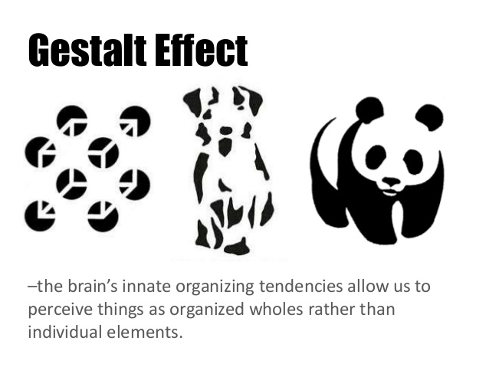
Gestalt principles of perceptual organization
brain’s innate organising tendencies allow us to perceive things as organised wholes than individual elements
main ideas:
we often experience things that are not a part of our simple sensations
perception of things is affected by the context
”The whole is something other than the sum of its parts”
can be summarized as a set of principles

Slide 46
Principle of Proximity
objects that are close to each other tend to be grouped together

Slide 47
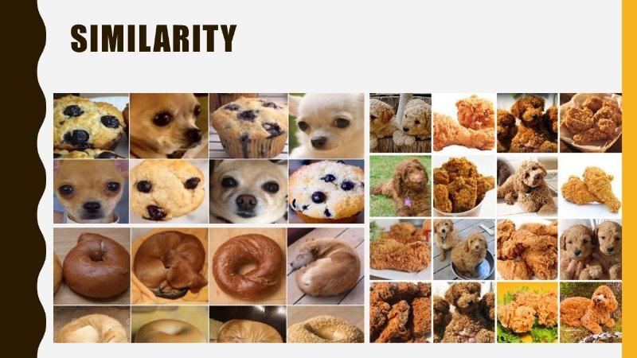
Principle of Similarity
objects that share visual characteristics such as colour, shape, size, texture, or orientation tend to be grouped together

Slide 48

Principle of Continuity
there is a preference for continuous figures

Slide 49
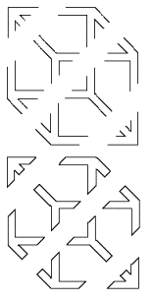
Principle of Closure
objects that seem to form closed entities tend to be grouped together

Slide 50


Principle of Closure, Continuity, & Figure-Ground
the perceptual system fills in the gaps where evidence is incomplete

Slide 51
Principle of Common Fate
objects that move together tend to be grouped together

Slide 52
Auditory scene analysis
tonotopic organization (Ress & Chandrasekaran, 2013)
three main categories
sequential integration - putting together events that follow one another in time
spectral integration - integrating components that occur at the same time in different parts of the spectrum
old-plus-new heuristic - perceptual continuation of old sound at the presentation of a more complex sound
Notes:
Specifically, the IC is the first processing node, which extracts complex sound features from the incoming sensory information and serves multisensory integration
IC play an important role in spectrotemporal variations inherent in communication signals. Animal models show that IC has neurone highly selective to direction of frequency modulations
Frequency gradient
IC considered for implants
The next processing node is the medial geniculate body (MGB),The MGB already shows less tonotopic organization
The MGB is sensitive to relatively fast modulation rates in sounds, it already processes complex sound information
The MGB is the last subcortical node in the ascending pathway, projecting directly to the auditory cortex (AC).

Slide 53
What do you hear?
On what basis are you segregating them into streams?

Slide 54
Cocktail party effect
tonotopic organization (Ress & Chandrasekaran, 2013)
Notes:
Specifically, the IC is the first processing node, which extracts complex sound features from the incoming sensory information and serves multisensory integration
IC play an important role in spectrotemporal variations inherent in communication signals. Animal models show that IC has neurone highly selective to direction of frequency modulations
Frequency gradient
IC considered for implants
The next processing node is the medial geniculate body (MGB),The MGB already shows less tonotopic organization
The MGB is sensitive to relatively fast modulation rates in sounds, it already processes complex sound information
The MGB is the last subcortical node in the ascending pathway, projecting directly to the auditory cortex (AC).

Slide 55
Sequential Integration

Slide 56
Streaming by Proximity
proximity in auditory domain:
proximity in time
proximity in pitch
auditory events that are proximal in pitch and/or time
are probably to be created by one and the same source
tend to be heard as a stream

Slide 57
Streaming by Proximity
Streaming by Proximity
interleaved melodies
increasing the height difference between melodies results in separation of auditory streams

Slide 58
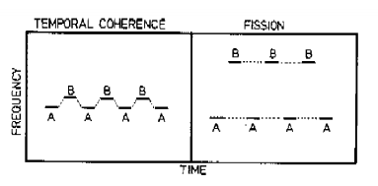
What is proximal enough for streaming to occur?
van Noorden (1975): dependence of streaming on repetition time and pitch interval
Temporal Coherence and Fission
occurrence of temporal coherence and fission is determined by the musical interval between the tones
Notes:
A study by van Noorden showed how frequency proximities can compete with one another. He found that a single pair of tones presented once ("one-shot" presentation) tended to remain coherent over much wider frequency separations than they would when cycled in a long sequence. 210 This may have been due to the fact that stream segregation takes time. However, another factor also seems to be playing a role in one-shot sequences: When only two tones are presented, there is no competition for the grouping of the high or the low one. The only sounds available for the two tones to group with are each other. This interpretation is supported by the results with one- shot sequences that consisted of three tones.

Slide 59
What is proximal enough for streaming to occur?
A: 2 streams
C: 1 stream
B: 1-2 streams (depending on attention)
Notes:
A study by van Noorden showed how frequency proximities can compete with one another. He found that a single pair of tones presented once ("one-shot" presentation) tended to remain coherent over much wider frequency separations than they would when cycled in a long sequence. 210 This may have been due to the fact that stream segregation takes time. However, another factor also seems to be playing a role in one-shot sequences: When only two tones are presented, there is no competition for the grouping of the high or the low one. The only sounds available for the two tones to group with are each other. This interpretation is supported by the results with one- shot sequences that consisted of three tones.

Slide 60
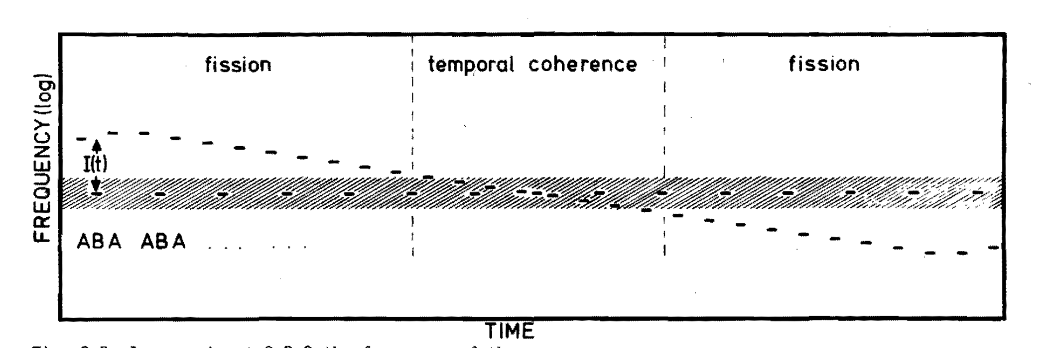
Temporal Coherence & Fission Boundaries
van Noorden (1975): dependence of streaming on repetition time and pitch interval
Temporal Coherence and Fission
occurrence of temporal coherence and fission is determined by the musical interval between the tones
Notes:
A study by van Noorden showed how frequency proximities can compete with one another. He found that a single pair of tones presented once ("one-shot" presentation) tended to remain coherent over much wider frequency separations than they would when cycled in a long sequence. 210 This may have been due to the fact that stream segregation takes time. However, another factor also seems to be playing a role in one-shot sequences: When only two tones are presented, there is no competition for the grouping of the high or the low one. The only sounds available for the two tones to group with are each other. This interpretation is supported by the results with one- shot sequences that consisted of three tones.

Slide 61
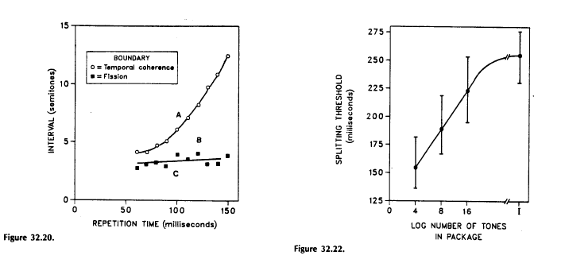
What is proximal enough for streaming to occur?
occurrence of temporal coherence and fission is determined by the musical interval between the tones
A: 2 streams
C: 1 stream
B: 1-2 streams (depending on attention)

Slide 62
Streaming by similarity
auditory streaming can be based on
similarity in pitch
similarity in loudness
similarity in timbre

Slide 63
Sequential Integration: Summary
depends on proximity of
time (onset)
pitch
Temporal Coherence and Fission (interval & repetition time)
depends on the similarity in
loudness
timbre

Slide 64
Spectral Integration

Slide 65
Spectral Integration
what kind of principles govern the integration of simultaneous auditory components into perceptual units?

Slide 66
Spectral Relations
grouping by harmonicity
frequency components sharing the same fundamental are probable to come from the same source and are grouped together

Slide 67
Common Fate
partials that are in a common harmonic series are more likely to be treated as the spectrum of a single sound.
when different partials in the spectrum undergo the same change at the same time, they are bound together into a common perceptual unit and segregated from partials whose time-varying behavior is different.
this principle applies both to changes in intensity and changes in frequency

Slide 68


Common Fate
grouping by onset (and offset)
frequency components having proximal onset times are probable to come from the same source and are grouped together
amplitude

Slide 69
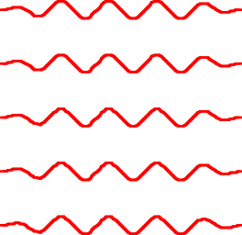
Common Fate: FM
spectral components sharing the same FM pattern are probably associated to the same source and are grouped together

Slide 70
Why does the singer use vibrato?

Slide 71
Why does the singer use vibrato?
auditory system looks for different sets of harmonic series and segregates them
to maintain perceptual distinctness is to be producing pitches that are not the same as those produced at the same time by the accompaniment - and hence stand out

Slide 72
Old-Plus-New Heuristic

Slide 73
Old-Plus-New Heuristic
perceptual continuation of old sound at the presentation of a more complex sound

Slide 74

Old-Plus-New Heuristic
perceptual continuation of old sound at the presentation of a more complex sound
“picket-fence effect”
Notes:
He has shown that the illusion can be obtained only when the interrupting noise would have masked the signal if it had really been there. The interrupting noise must be loud enough and have the right frequency components to do so.

Slide 75
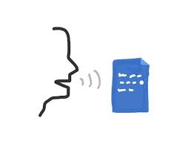

Apparent continuity through perceptual completion
if a spectrum suddenly becomes more complex or more intense, it is interpreted as the old sound continuing joined by a new one

Slide 76
Summary
Σ
Auditory Scene Analysis
formation of auditory streams (perceptual grouping)
much of it can be explained by Gestalt principles
main types of ASA processes
sequential integration
spectral integration
old-plus-new heuristic

Slide 77
Summary
Σ
sequential integration
proximity in time and/or pitch
similarity in loudness/timbre
spectral integration
proximal onset & offset times
spectral relations (harmonicity)
common fate
old-plus-new heuristic
apparent continuity

Slide 78
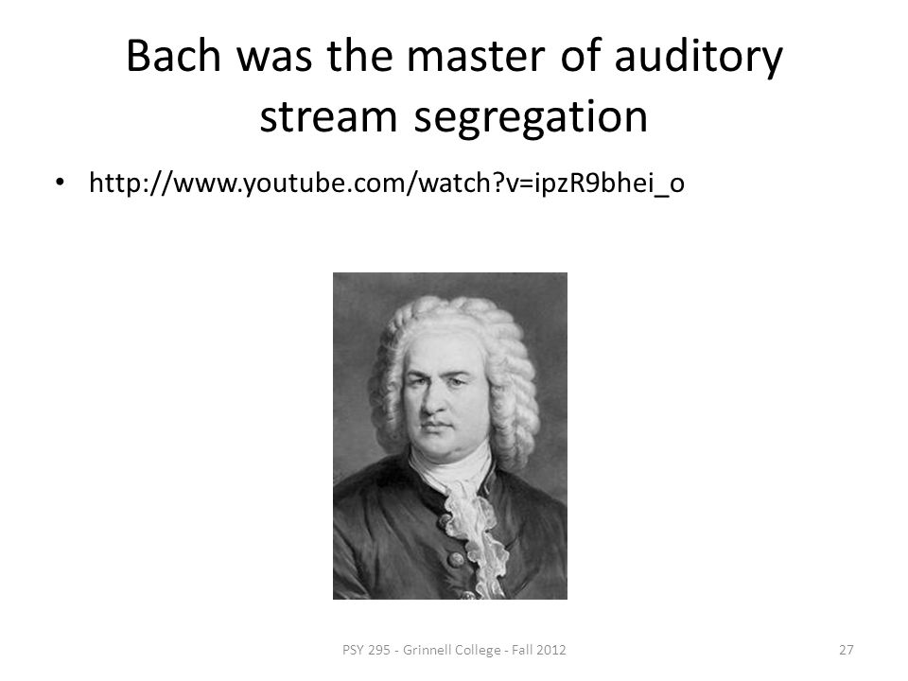

Gestalt principles of perceptual organization
Figure-ground (Pragnanz)
Organization depends on what we see as figure (object) and what we perceive as ground (context)..
Closure
We perceive figures with gaps in them to be complete (filling-in).

